Slide 1
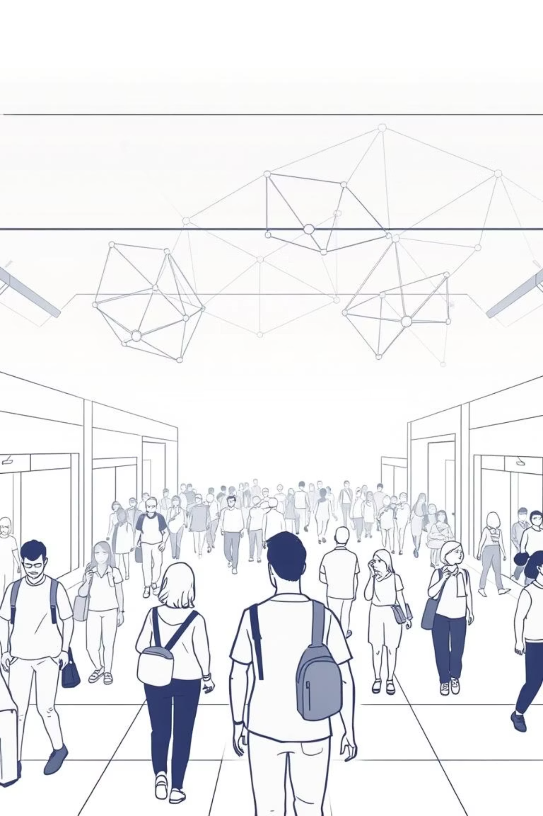


A Social Distance Detector to Curb Airborne Diseases
A Computer Vision & Web Application Project

Slide 2
The Challenge: Preventing Airborne Disease Transmission
Airborne diseases, such as COVID-19, Influenza, and Tuberculosis, spread rapidly through respiratory droplets. A fundamental strategy to mitigate their transmission is maintaining a safe social distance. Traditional methods of enforcement are often manual, resource-intensive, and lack real-time adaptability.
The Problem
Our Solution
Manual social distancing enforcement is inefficient and not scalable in large public spaces.
An automated, real-time computer vision system for proactive public health monitoring.

Slide 3



Project Goal: Real-Time Social Distance Monitoring
Our primary objective is to develop a robust computer vision application capable of real-time monitoring of social distancing in live video streams. This system aims to provide instant visual feedback on compliance, fostering safer public environments.
Person Detection
Distance Calculation
Violation Alerts
Accurately identify and locate individuals in a live feed.
Measure real-time distances between detected individuals.
Trigger visual alerts for breaches of set social distance thresholds.

Slide 4
Technical Stack: Powering the Vision
The project leverages a robust set of open-source technologies to ensure high performance, scalability, and ease of deployment. Python serves as the core programming language, enabling efficient integration of various libraries.
Core Technologies
Specialized Libraries
Python: Primary programming language for all logic and integrations.
YOLOv5: State-of-the-art deep learning model for accurate, real-time person detection.
Django: Web framework for a responsive front-end and robust server.
NumPy: Powers high-performance numerical operations crucial for calculations.
OpenCV: Essential for video processing, frame manipulation, and camera interaction.
imutils & SciPy: Helper libraries for streamlined image processing and complex distance algorithms.

Slide 5


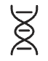
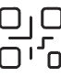

Implementation Steps: From Concept to Code
Our development process followed a structured approach, focusing on modularity and efficient integration to build a seamless real-time monitoring system.
Project Setup
Modular structure with main app and YOLOv5 sub-folder.
Environment Config
Ensured compatibility with specific library versions via requirements.txt.
Model Integration
YOLOv5 for accurate person detection and bounding box placement.
Core Logic
Python script for video capture, frame processing, and distance calculation.
Web Integration
Converted desktop app to Django web app, streaming frames to the browser.

Slide 6
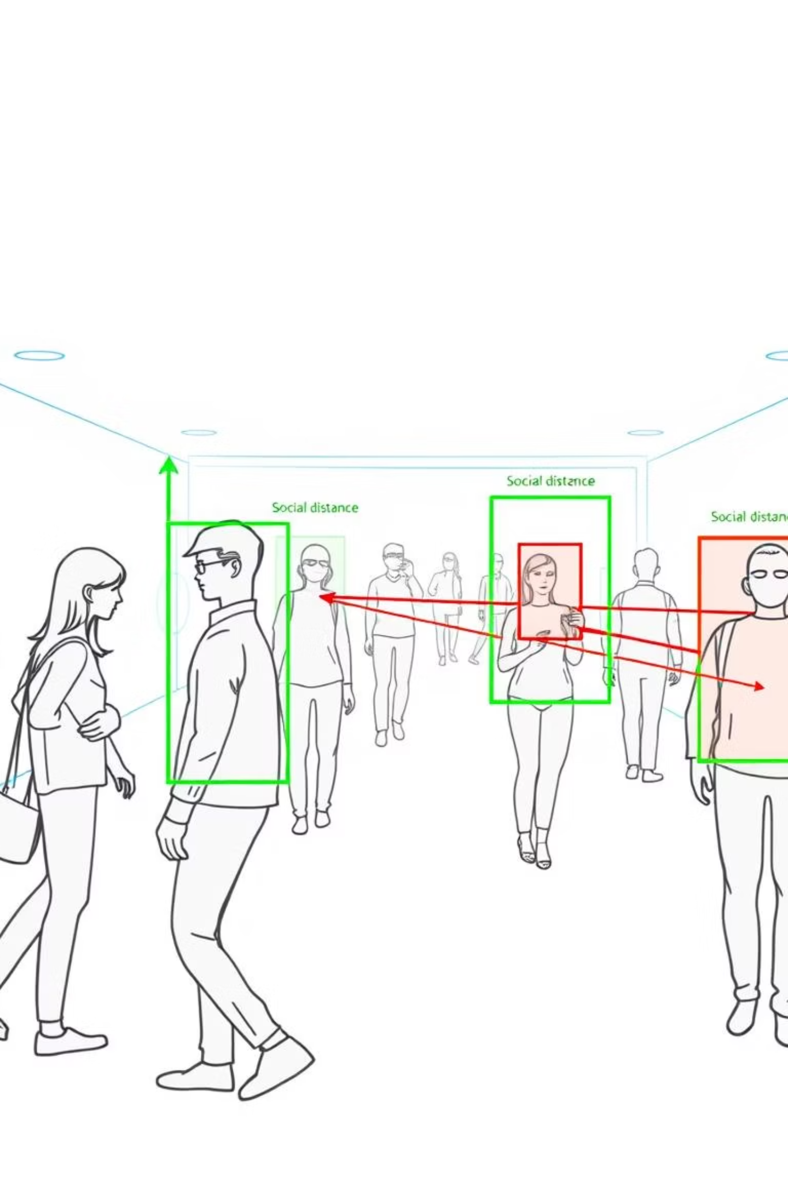
Demo & Results: Seeing is Believing
The web interface provides an intuitive and immediate visual representation of social distancing compliance. This real-time feedback loop is crucial for effective public health management.
Live Feed: Displays real-time video from a webcam.
Visual Alerts: Green boxes for safe distances, red boxes and lines for violations.
Real-time Counter: On-screen display of current social distancing violations.

Slide 7
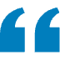
Overcoming Technical Hurdles
Throughout the development, several challenges emerged, typical in complex integrations. Our systematic approach to problem-solving ensured the project's successful completion.
Library Incompatibility
Path Errors with Spaces
Django Video Streaming
Problem: Errors due to mismatched versions of Python, NumPy, and OpenCV.
Problem: YOLOv5 model path failed with spaces in folder name.
Problem: Inconsistent camera stream to the web page.
Solution: Optimized code to load model once and manage video capture globally.
Solution: Installed stable, verified versions (Python 3.12, numpy==1.26.4, opencv-python==4.8.1.78).
Solution: Renamed folder to "social-distance-detector" and used relative paths.

Slide 8
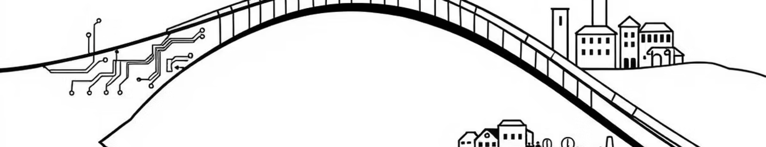
Why this matters
Bridging the gap between cutting-edge technology and public health needs.

Slide 9
Conclusion: A Scalable Public Health Solution
This project successfully demonstrates the immense potential of computer vision in addressing real-world public health challenges. By providing an automated, real-time social distance monitoring system, we offer a proactive tool for disease prevention.
Real-World Impact
Accessible & Web-Based
Scalable Prevention
Successfully applies computer vision for practical applications.
Tool can be accessed and utilized from any device with a browser.
Promotes public health awareness across diverse environments.

Slide 10

Thank you!
We believe this project sets a strong foundation for future advancements in AI-driven public health initiatives.
Questions?

